Slide 1
YALAVARTHI SRI SAI KRISHNA PRAGNA Final Project
3/21/2024 Annual Review

Slide 2
PROJECT TITLE
KEYLOGGER AND SECURITY
3/21/2024 Annual Review

Slide 3


AGENDA
In this presentation, we will start with an introduction that provides an overview of key loggers and their significance in cybersecurity. We will then define key loggers, explaining the differences between software-based and hardware-based types. Next, we will delve into the various types of key loggers, discussing software-based key loggers such as kernel and API-based, as well as hardware-based key loggers like keyboard hardware and external devices.
Following this, we will explain how key loggers operate, focusing on the mechanisms they use to
capture keystrokes and how this data is transmitted to attackers. We will examine the potential impacts of of key loggers, including personal risks such as identity theft and financial loss, as well as corporate risks risks like data breaches and intellectual property theft. We will also consider the broader I Implications for privacy and trust.
Lastly, we will discuss how to detect key loggers by identifying symptoms and
using detection tools and methods, as well as prevention strategies
to protect against key loggers.
3/21/2024 Annual Review

Slide 4

PROBLEM STATEMENT
The increasing threat of key loggers presents serious dangers to our personal privacy, financial security, and the integrity of organizations. Cyber attackers are using advanced key logging techniques to steal sensitive information like passwords, credit card numbers, and confidential business data. It's crucial for both individuals and organizations to improve their understanding and application of effective security measures. This presentation will explain how key loggers work, discuss their potential impacts, and outline the steps needed to detect, prevent, and respond to key logger attacks. Our goal is to help create a safer digital environment for everyone.
3/21/2024 Annual Review

Slide 5

PROJECT OVERVIEW
This presentation, titled "Key Loggers and Security," aims to provide a comprehensive understanding of key loggers, their impact, and strategies to protect against them. We will begin with an introduction to key loggers, defining what they are and distinguishing between software-based and hardware-based types. Next, we will explore how key loggers operate, including the mechanisms they use to capture keystrokes and transmit this information to attackers.
We will discuss the potential impacts of key loggers, covering personal risks like identity theft and financial loss, as well as corporate risks such as data breaches and intellectual property theft. Additionally, we will examine how to detect key loggers by identifying symptoms and indicators and using available detection tools. Finally, we will highlight preventive measures and advanced security strategies to protect against key loggers.
3/21/2024 Annual Review

Slide 6

WHO ARE THE END USERS?
Identification of Potential End Users: Individuals, Businesses, Organizations
Understanding Their Needs and Concerns Regarding Keylogger Protection
Tailoring Solutions to Meet the Requirements of Various User Groups
6
3/21/2024 Annual Review

Slide 7

YOUR SOLUTION AND ITS VALUE PROPOSITION
My strategy to combat key loggers is thorough and multifaceted. It combines education, advanced detection tools, preventive measures, and strong incident response plans. We focus on raising awareness through regular training sessions and educational materials, emphasizing the importance of safe online practices. To detect and remove threats, we use advanced anti-malware software and real-time monitoring. Additionally, we advocate for keeping software up-to-date, using multi-factor authentication, and employing encryption to prevent vulnerabilities. Finally, our clear incident response protocols, informed by real-world case studies, ensure we can take effective action as soon as a key logger is detected.
3/21/2024 Annual Review

Slide 8

THE WOW IN YOUR SOLUTION
My approach to fighting key loggers is comprehensive and layered. It starts with education: we regularly conduct training sessions and provide materials to emphasize the importance of safe online practices. For detecting and eliminating threats, we rely on advanced anti-malware software and real-time monitoring. We also stress the importance of keeping software updated, using multi-factor authentication, and employing encryption to protect against vulnerabilities. Lastly, we have clear incident response protocols, backed by real-world examples, to ensure we can act swiftly and effectively if a key logger is found.
3/21/2024 Annual Review
8

Slide 9
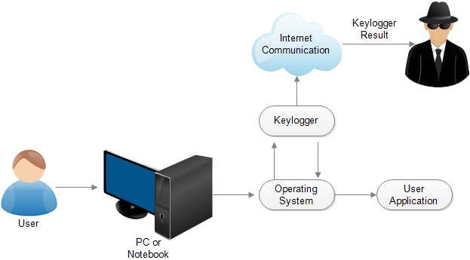
MODELLING
MODELLING
Teams cam add wireframes
3/21/2024 Annual Review
9
3/21/2024 Annual Review
9

Slide 10
RESULTS
Our multifaceted security strategy significantly reduces keylogger attack risks.
Enhanced awareness and preparedness empower users to identify and avoid threats. With advanced detection tools and proactive measures, we ensure robust protection, complemented by clear incident response plans for swift action. The result is peace of mind, cost savings, reduced risk, and enhanced trust, effectively safeguarding financial and reputational integrity.
“Block Keyloggers, Boost Security.”
3/21/2024 Annual Review
10

Slide 11
Git-hub link :
https://github.com/2200030505/APSSDC_project.git

